Slide 1
Chapter 7
Using a Server

Slide 2
Object
• Explain how to use a server in a home or office network
• Install a server
• Explain server virtualization and virtual networks
• Understand typical management services provided by a server
• Understand new networking features for Windows Server 2012
• Set up a server
• Manage and monitor a server
• Design a server-based office network
http://fpt.edu.vn

Slide 3
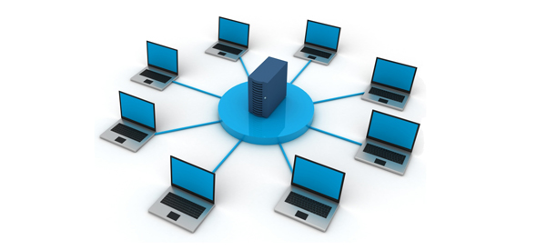
Using a Server in a Home Network
• Store and play selections in a large music library
• Entertainment center
• Combine the needs of a home network and home office network
• Central management and storage for backing up
• Share an Internet connection, providing better response for simultaneous use than one shared from a workstation
http://fpt.edu.vn
Notes:
Read carefully the scenario in Chapter 6

Slide 4
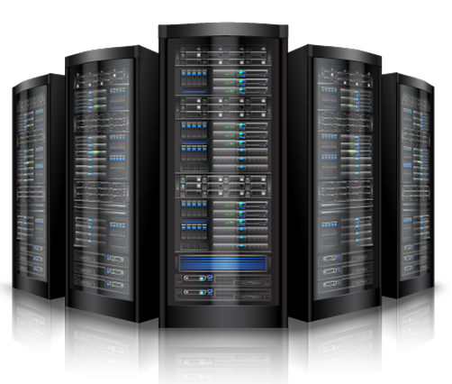
Using a Server in an Office Network
• Powerful resource sharing with less delay than workstations on a peer-to-peer network.
• Central management of shared resources.
• Centralized network authorization when users access the network.
• As data files and databases grow in size, they require a server for efficient processing, management, and distributed access.
• A server has more networking tools available than a workstation.
http://fpt.edu.vn

Slide 5
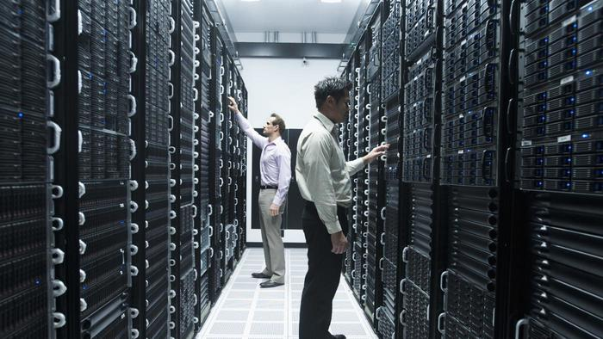
Installing a Server
Several factors to consider:
What type of computer to use
  CPU, Ram, Disk
  Vendors: IBM, Dell, Hp…
  Windows / Linux
Where to locate a server
  Uninterruptible power supply (UPS)
  Blade server / blade enclosure
  Rack-mounted server
  Server farm
Who should manage a server
http://fpt.edu.vn

Slide 6
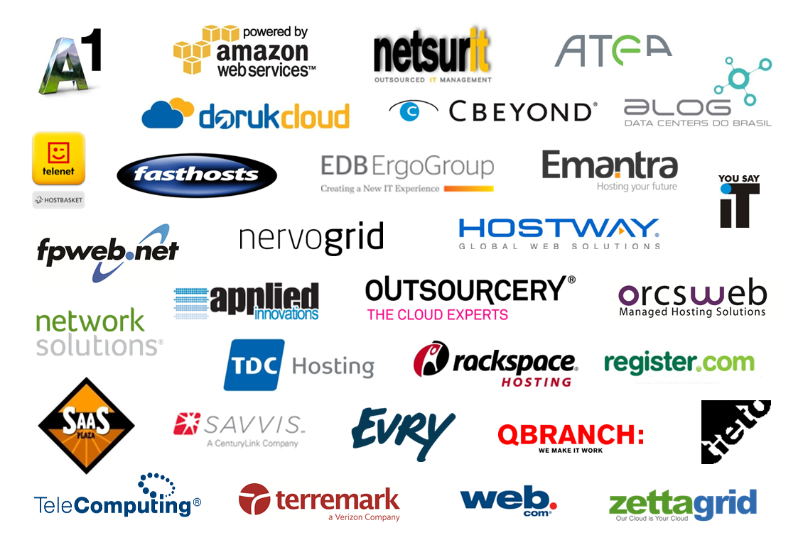
Windows Server 2012 on the Network
Partner Momentum
with Windows Server 2012 & System Center 2012
50+ Industry leading partners are already building services with our newest technologies
http://fpt.edu.vn

Slide 7

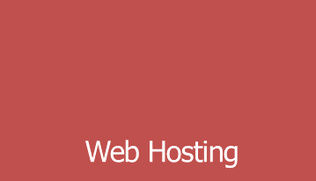
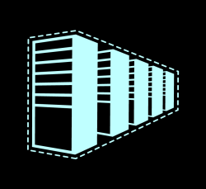
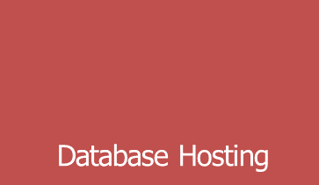
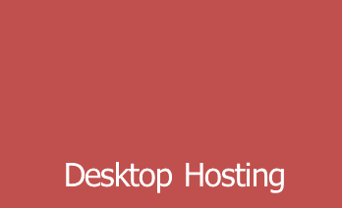
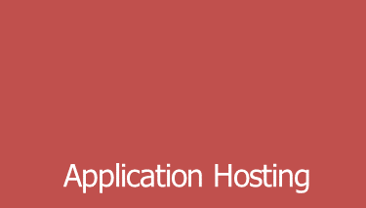
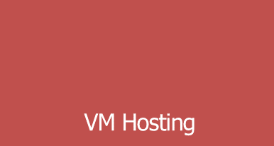







Windows Server 2012 on the Network
Your Customer Offers Powered by Microsoft
Websites as a Service
Windows Server Hosted
SQL Database Hosted
Database-as-a-Service
Business Apps
Productivity Suite Apps:
Unified Communication
Content Management and Collaboration
Exchange
Hosted Desktop and apps
High Availability
http://fpt.edu.vn

Slide 8

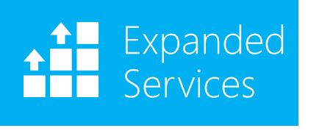


Windows Server 2012 on the Network
Windows Server 2012: What’s New
Designed for Hosting Service Providers to drive lower infrastructure TCO and deliver new business opportunities
Comprehensive Cloud Platform
Cost
Efficiency
Top Features for Service Providers
1
2
3
4
5
Disaster Recovery with Hyper-V Replica
Web-Farm Scalability with IIS8
Network
Virtualization
VM Scalability & Performance
Storage Spaces
6
7
8
9
10
Live Storage Migration & Shared Nothing Live Migration
RDS Improvements for Desktop Hosting
Granular Resource Metering
Hyper-V Extensible Switch
Data
De-Duplication
http://fpt.edu.vn

Slide 9
Windows Server 2012 on the Network
Windows Server 2012
Advantage for Hosting Service Providers
Category |  | Resource | Microsoft |  | VMware | Advantage
 |  |  | Windows Server 2008 R2 | Windows Server 2012 | vSphere 5.0 Enterprise Plus
Scalability/ Performance/ Density | VM | Active VMs per Host | 384 | 1,024 | 512 | Microsoft
 |  | Memory per VM | 64 GB | 1 TB | 1 TB | -
 |  | Virtual Processors per VM | 4 | 32 | 32 | -
 | Cluster | Maximum Nodes | 16 | 64 | 32 | Microsoft
 |  | Maximum VMs | 1,000 | 4,000 | 3,000 | Microsoft
 | Network | High performance with SR-IOV | No | Yes | No | Microsoft
Storage |  | Native 4-KB Disk Support | No | Yes | No | Microsoft
 |  | Maximum Virtual Disk Size | 2 TB | 64 TB | 2 TB | Microsoft
 |  | Encrypted Cluster Storage | No | Yes | No | Microsoft
Secure Multi-tenancy |  | Open Extensible Switch | No | Yes | No | Microsoft
 |  | Confirmed Partner Extensions | - | 4 | 2 | Microsoft
 |  | Trunk Mode to Virtual Machines | Yes | Yes | No | Microsoft
 |  | Resource Metering | No | Yes | Partner | Microsoft
Flexible Infrastructure |  | 1GB Simultaneous Live Migrations | 1 | Unlimited | 4 | Microsoft
 |  | 10GB Simultaneous Live Migrations | 1 | Unlimited | 8 | Microsoft
 |  | Shared Nothing Live Migration | No | Yes | No | Microsoft
 |  | Network Virtualization | No | Yes | Partner | Microsoft
High Availability |  | Guest OS Application Monitoring | Yes | Yes | Partner | Microsoft
 |  | Guest Clustering with Live Migration | No | Yes | No | Microsoft
http://fpt.edu.vn

Slide 10
Virtualization
Server virtualization:
  You can create and run multiple computer operating systems on a single physical computer
  Host servers share resources with all the virtual machines
Virtualization challenges:
  Limited number of compute resources
Server virtualization features:
  Hyper-V server virtualization feature allow full utilization of physical resource and provide advanced technology to make a more robust, available and dynamic server computing environment.
Type II Hypervisor
Linux
virtual machine
Linux
virtual machine
Linux
virtual machine
Linux
virtual machine
Paravirtualization drivers and tools
Hypervisor (Microsoft Virtual Server, VMware workstation)
Host – Operating system
Host – Physical hardware
http://fpt.edu.vn

Slide 11
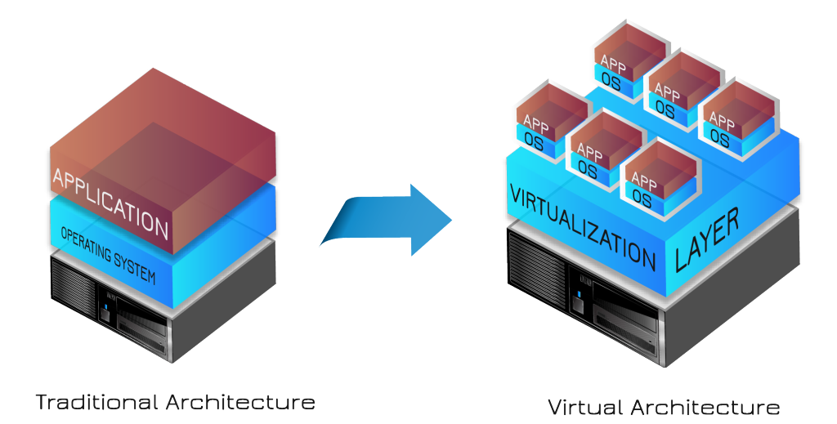
Virtualization
Virtualization is the ability to disguise the physical or individual hardware elements of computing to enhance or multiply resources
  Server virtualization
  Workstation or PC virtualization
  Application virtualization
  Storage virtualization
  Hardware or CPU virtualization
  Network virtualization
http://fpt.edu.vn

Slide 12
Reasons for Virtual Servers
Reasons for Virtual Servers
  Reduce the number of computers
  maintaining servers
  consolidate servers into fewer physical computers
Virtual Networks
  External virtual network
  Internal virtual network
  Private virtual network
http://fpt.edu.vn

Slide 13

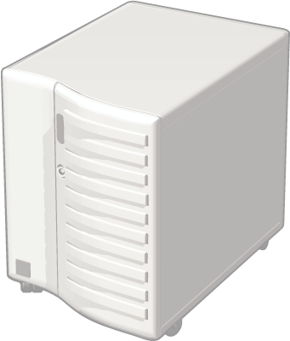
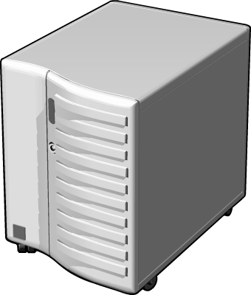
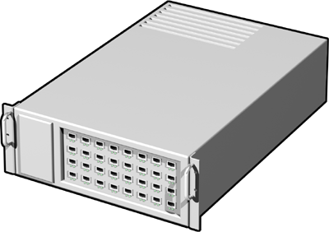
What Is Network Virtualization?
Blue virtual machine
Red virtual machine
Blue network
Red network
virtualization
Physical
server
Physical
network
Switches
Servers
Server virtualization runs
multiple virtual servers
on a physical server
Network virtualization runs multiple virtual networks
on a physical network
http://fpt.edu.vn

Slide 14
Server Functions in Windows Server,
UNIX/Linux, and Mac OS X Server
Directory services, such as Active Directory in Windows Server systems
User account management with more extensive setup options and security
E-mail server services
DHCP and DNS server services
Large-scale file and folder sharing services
Database services
Network security management
Web server and Web applications
Cloud services
http://fpt.edu.vn

Slide 15
Setting Up a Server
Create user accounts.
  stand-alone server
  Active Directory
Optimize the performance of a server.
Configure shared resources.
Configure remote services.
http://fpt.edu.vn

Slide 16
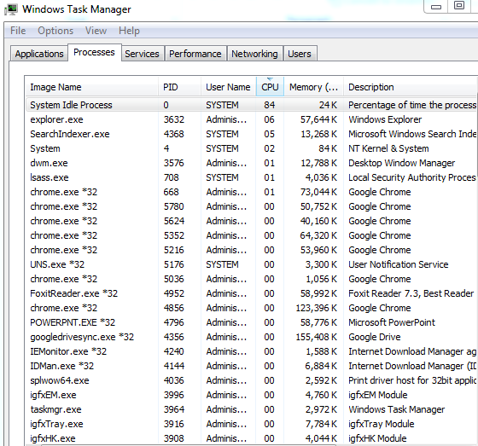
Managing Your Server
Managing and Monitoring Applications
Managing and Monitoring Processes
Monitoring Services
Monitoring Real-Time Performance
Monitoring Network Performance
Monitoring Users
http://fpt.edu.vn

Slide 17
Q & A
http://fpt.edu.vn

